Slide 1

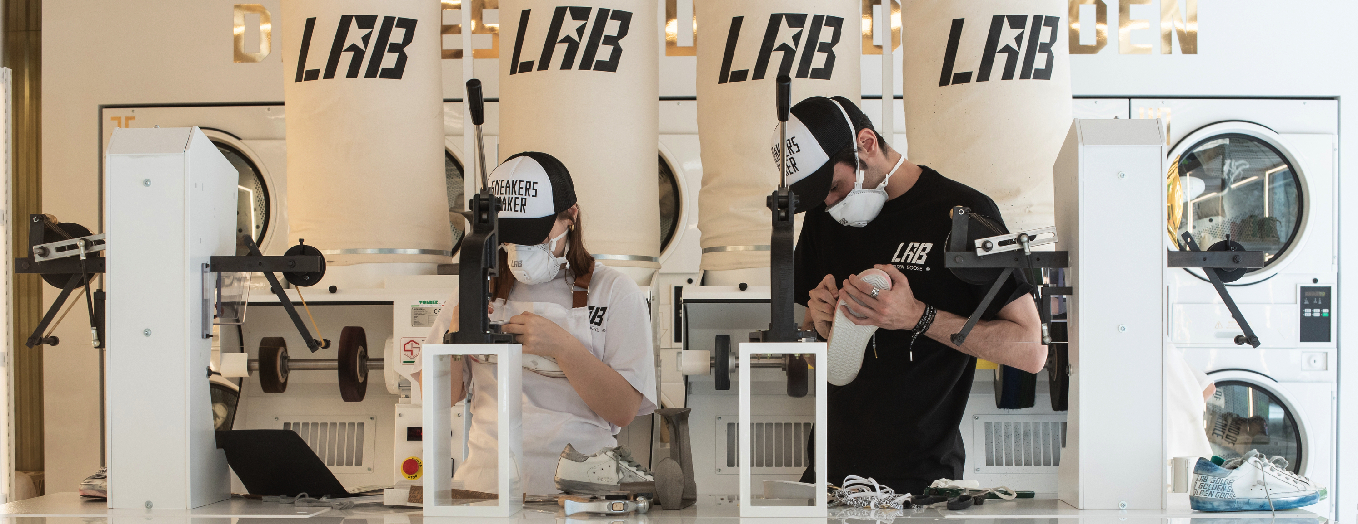
WE ARE LOOKING FOR…
SNEAKERS MAKER

Slide 2
WHO ARE WE AND WHAT ARE OUR FOUNDING VALUES?
Golden Goose is a Venetian story built from family, love, Italian craftsmanship, and travel.
These attitudes represent our unique and authentic way of expressing luxury.
From the beginning, Golden Goose has distinguished itself with innovative but artisan spirited products,
low-key communication strategy and highly selective placement in venues and locations that share the brand’s philosophy.
Since our foundation, Golden Goose has created a complete lifestyle for customers, offering collections that include
ready-to-wear, accessories and footwear in general and sneakers in particular, combining a familiar modern style
with a vintage feeling, all supported by a strong Italian sartorial tradition.
The Golden Goose continues to be about timeless emotions, relationships and products.

Slide 3
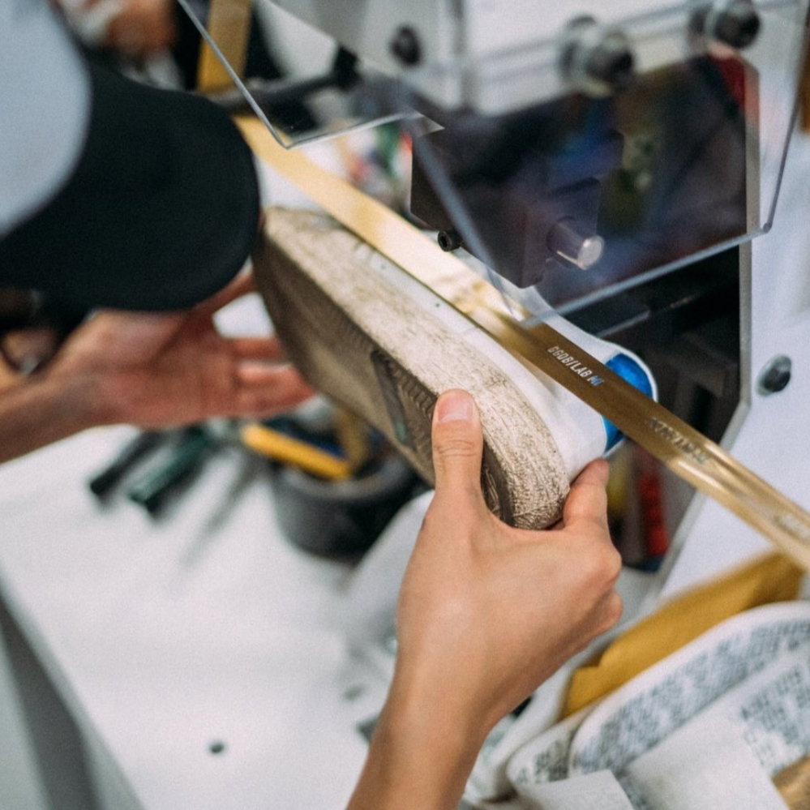
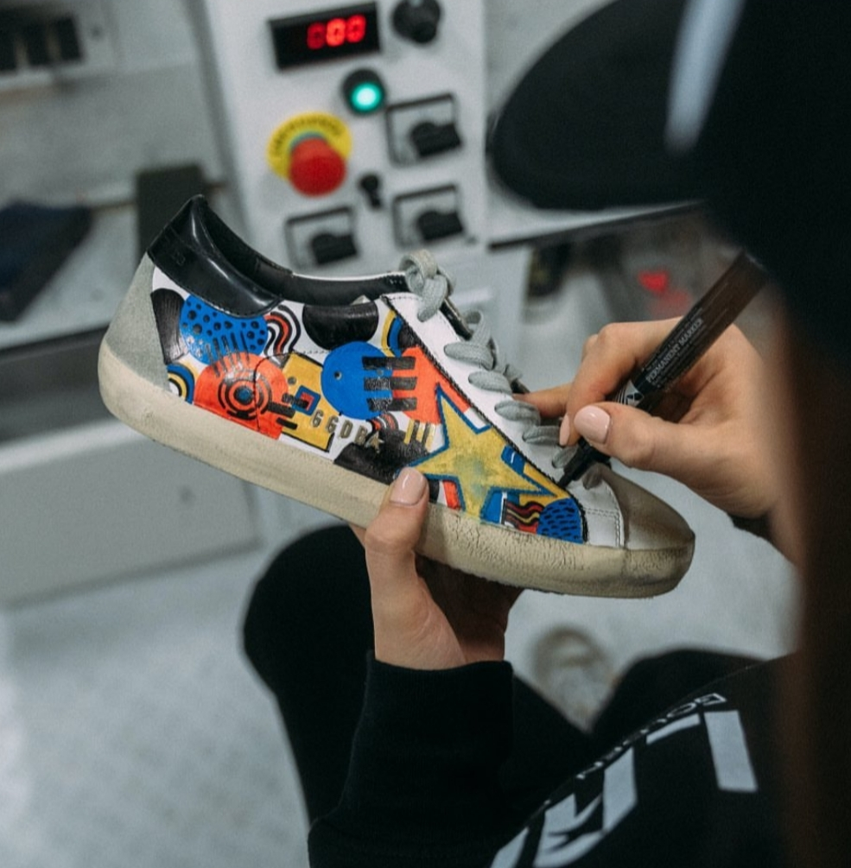
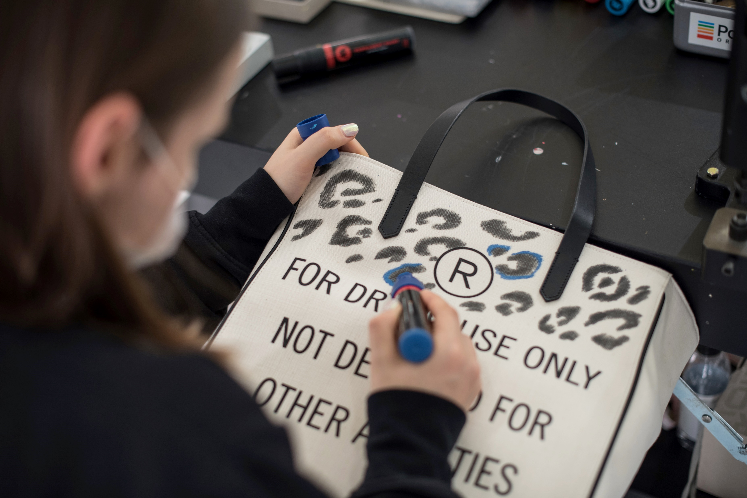
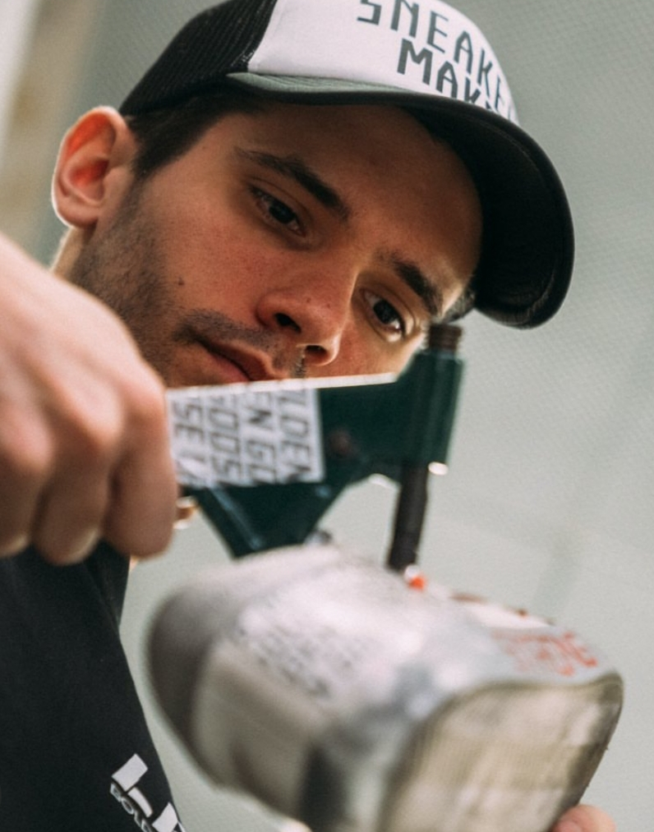
WE NEED YOU TO DO…
HANDMADE CUSTOMIZATION WITH SPECIAL TOUCH
Customize the products (Sneakers, Bags, RTW) using a variety of tools
Engrave messages of love; Golden Goose’s value on a sneakers
Add vintageness according to the customer's needs with simple processing handling.

Slide 4
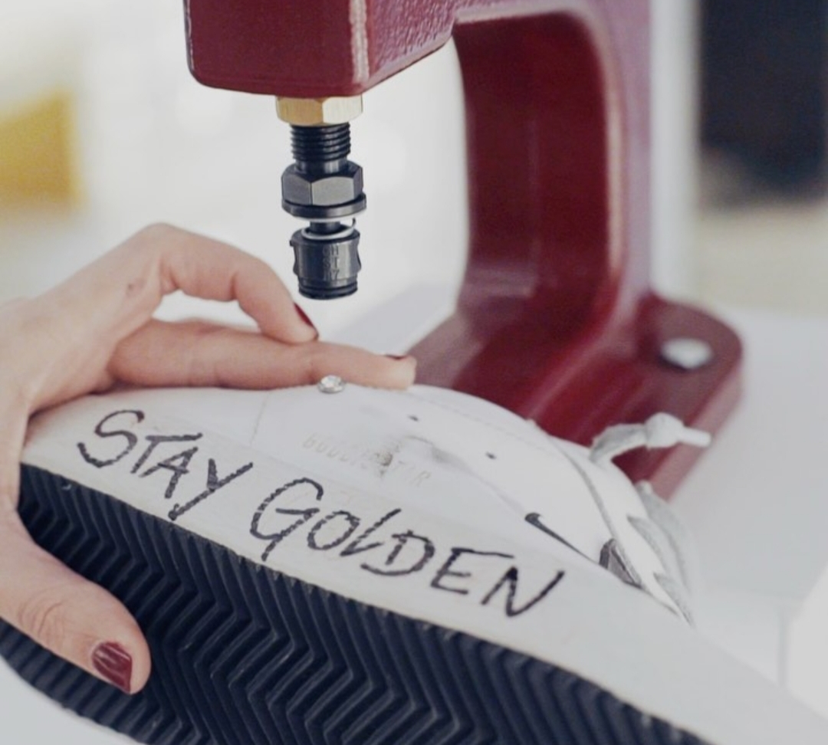
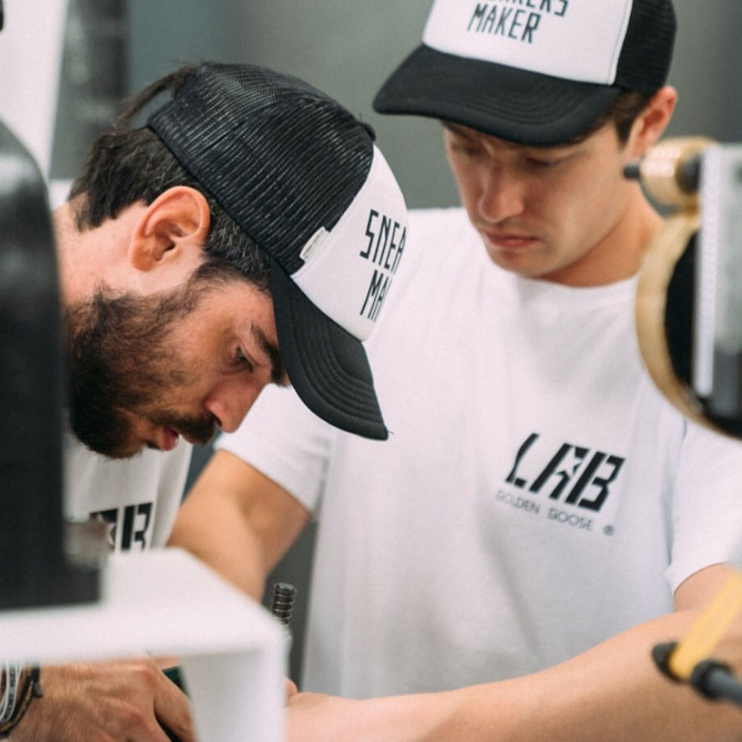
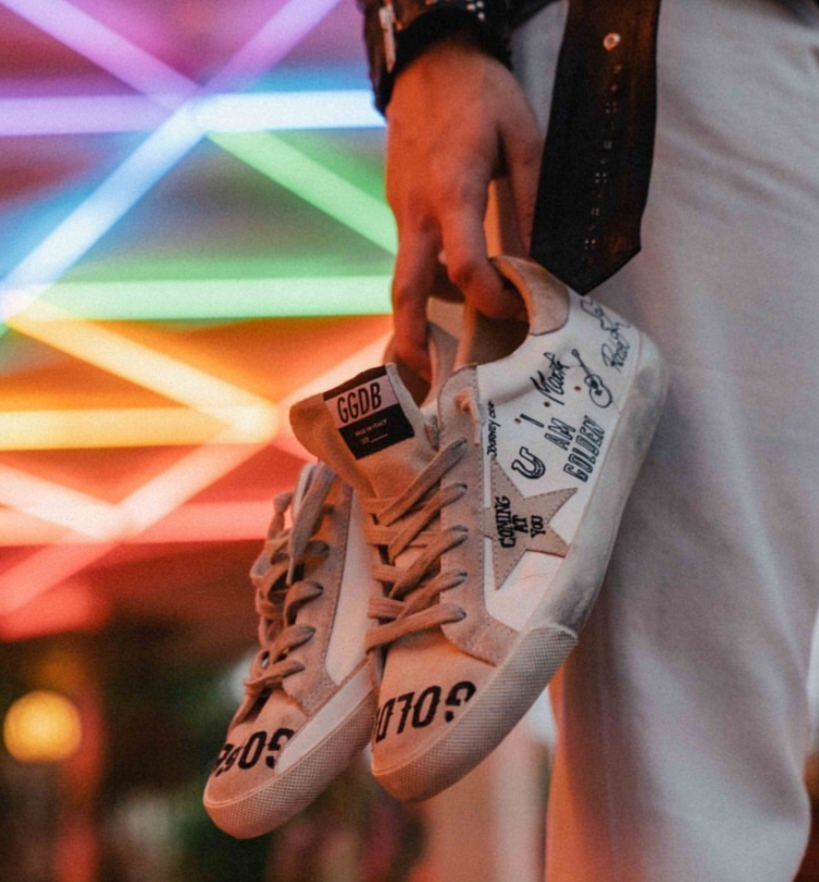
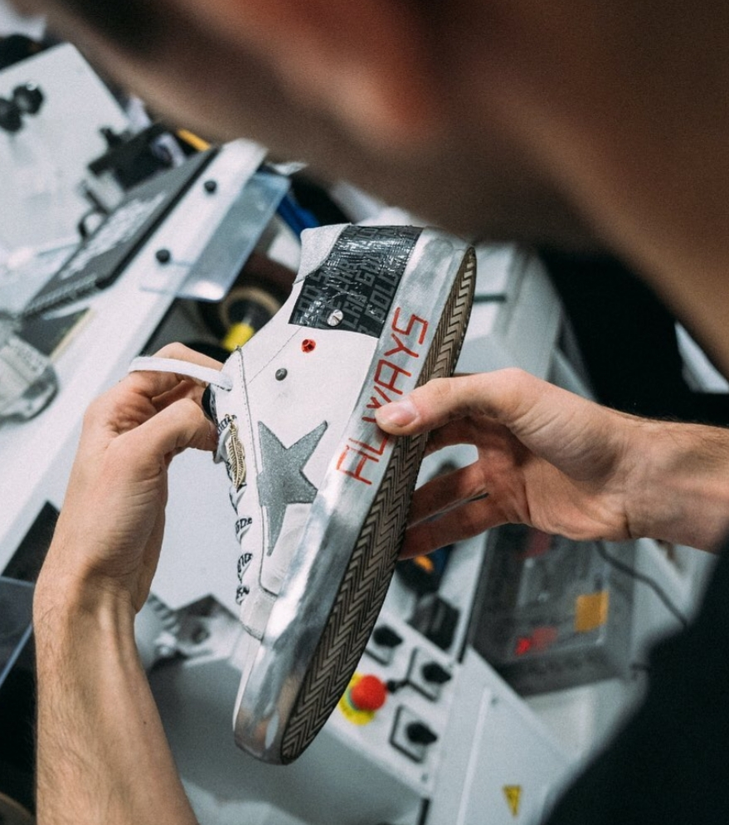
WOULD BE PERFECT IF YOU ARE…
- Majored in Art / Design / Fashion
- Interested in drawing with various tools
- Interested in FASHION/ART Industry

Slide 5
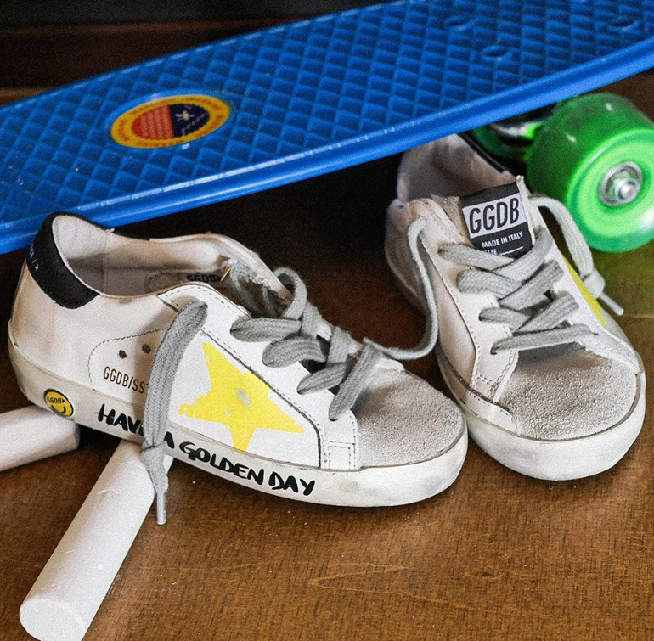
YOU CAN REACH US…
Email : korea-hr@goldengoose.com
WE ARE WAITING FOR YOU ☺

