Slide 1
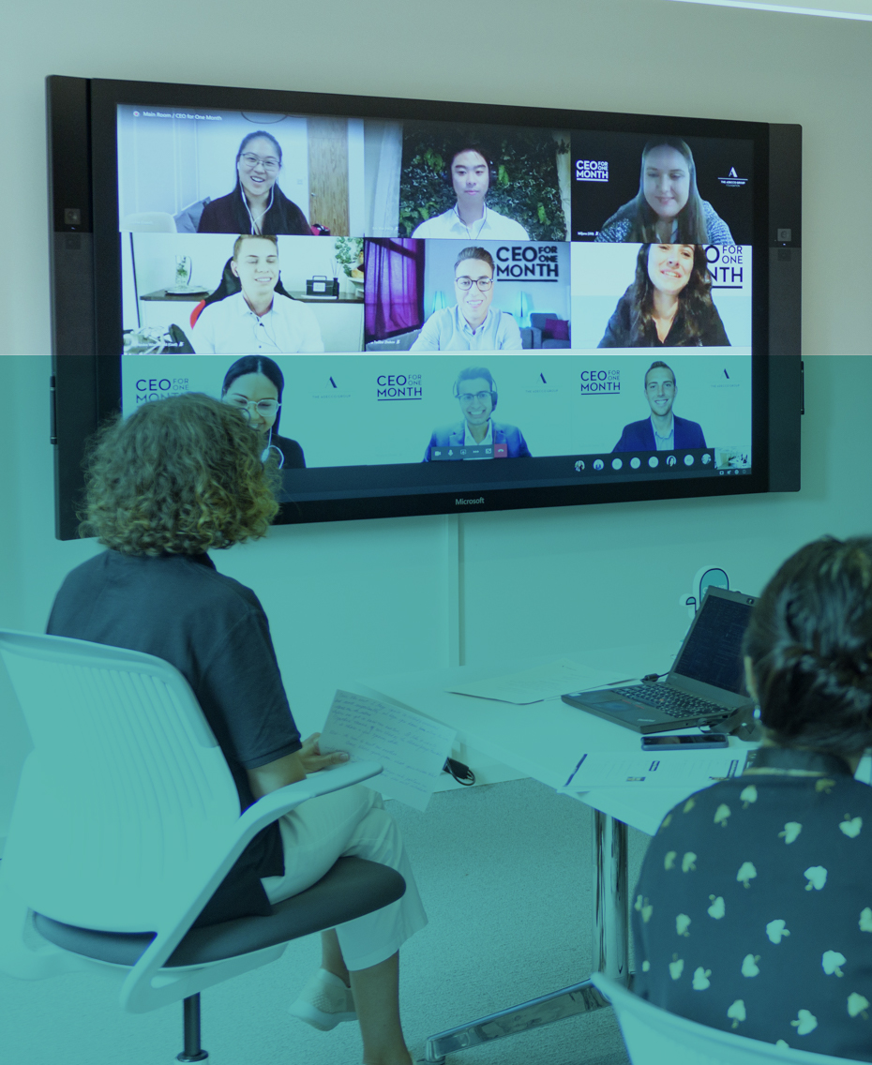

Slide 2
Help your students shape their
future

Slide 3
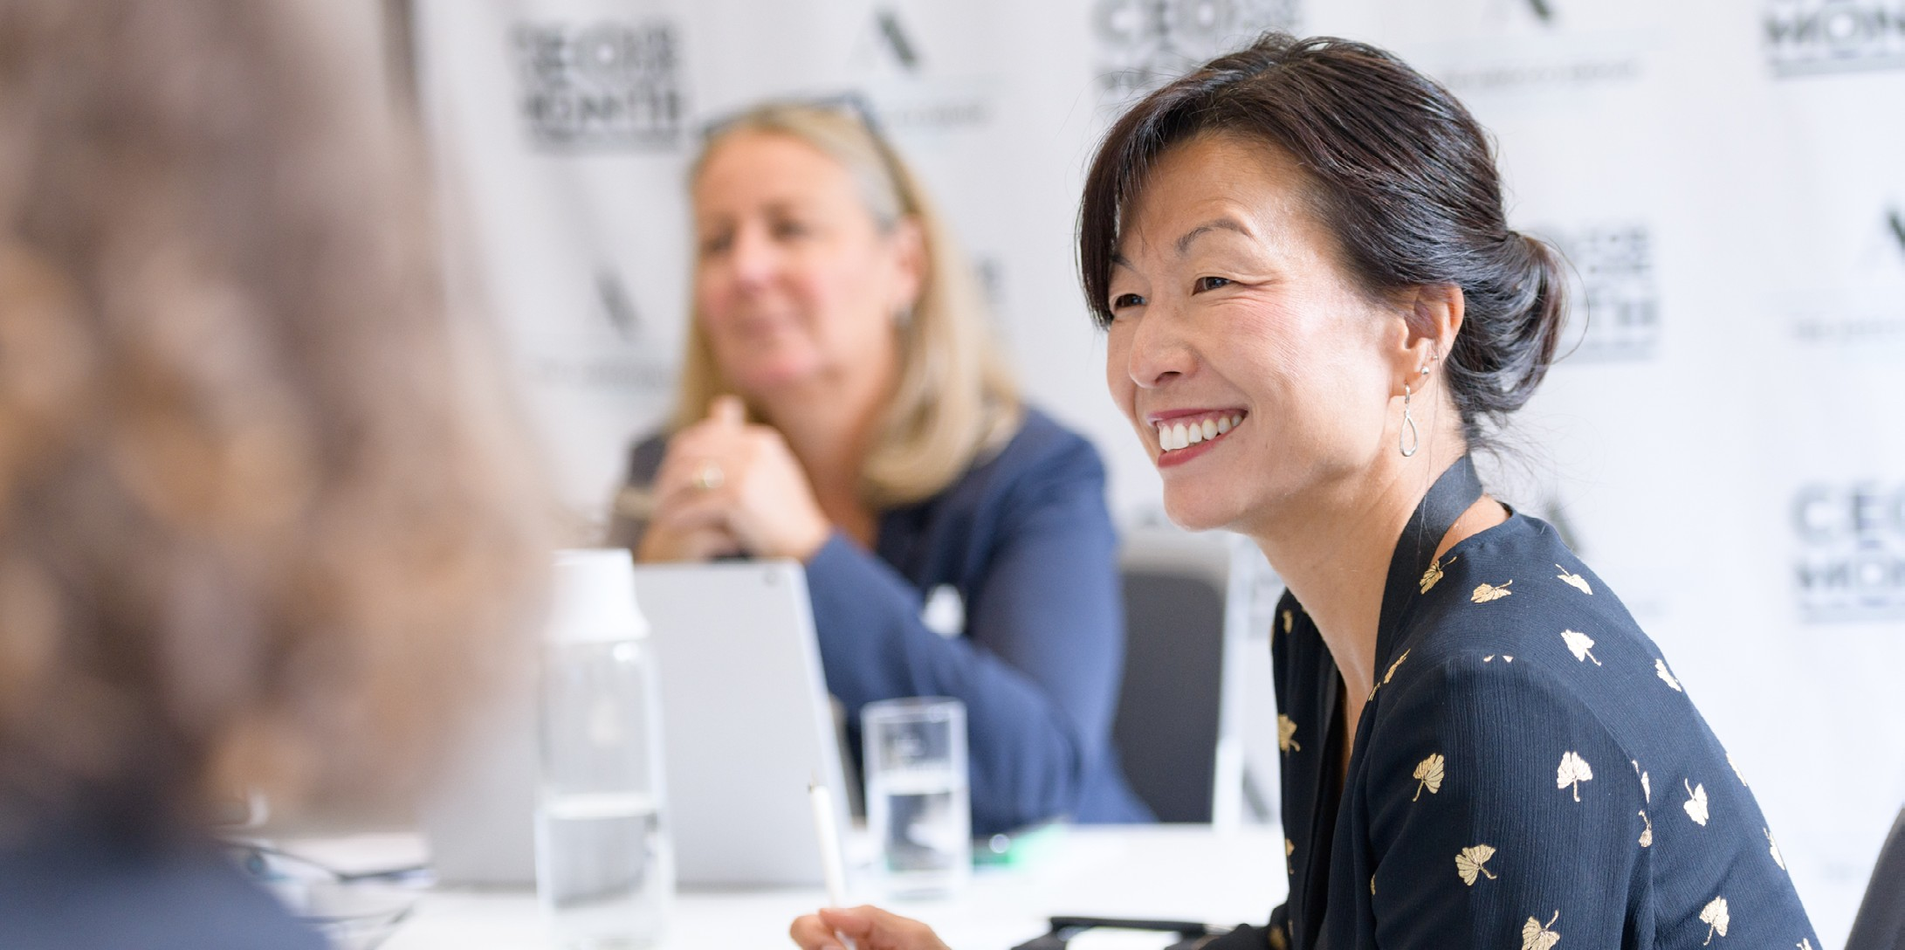
Young people under the age of 25 are three times more likely to be unemployed than any other age group
1.1 billion jobs will fundamentally change due to technological progress through the next decade
40% of employers state that they can’t find talent with the skills their businesses need. Lack of work experience is one of the main barriers
Internships and apprenticeships are becoming a crucial part of career development
The Adecco Group is the world’s leading HR solutions partner with more than 36,000 employees in 60 countries.
We transform the world of work one job at a time.
As part of the Adecco Group, we have created initiatives guided to tackle youth unemployment and skills shortages, and to empower young people with the skills and experience necessary to shape their future.
Let’s present them!

Slide 4
Initiatives for your
students

Slide 5
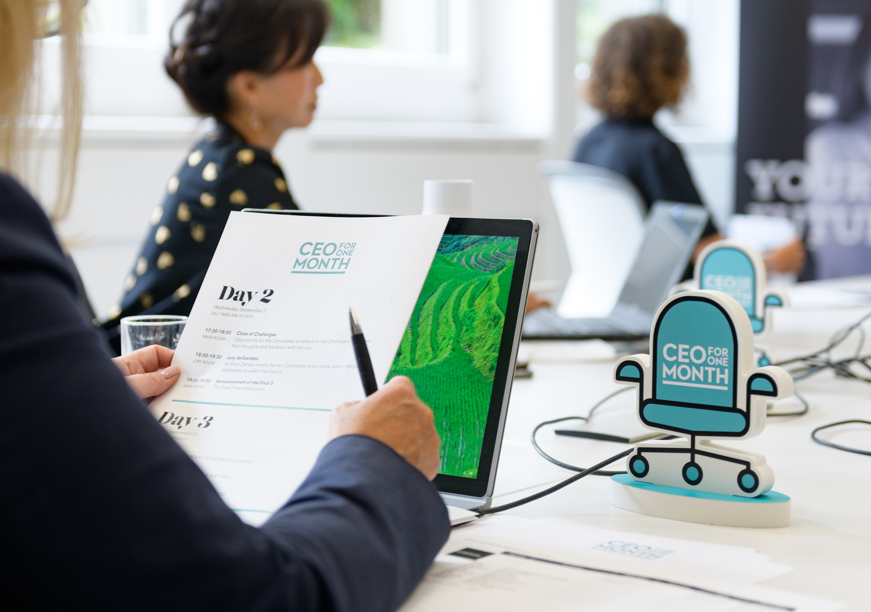
What is the ‘CEO for One Month’ Programme?
Through the last 7 years, nearly 300 talented young people have had the opportunity to shadow the Adecco Group leadership in their country of residence for one Month, experiencing first hand what it takes to run a country branch of major international company.
One exceptional candidate is also chosen each year to shadow the global CEO of the Adecco Group each year.
Since 2015, the ‘CEO for One Month’ Programme has grown from 32,000 to over 200,000 applicants, showcasing the growing importance of and interst in internships.

Slide 6
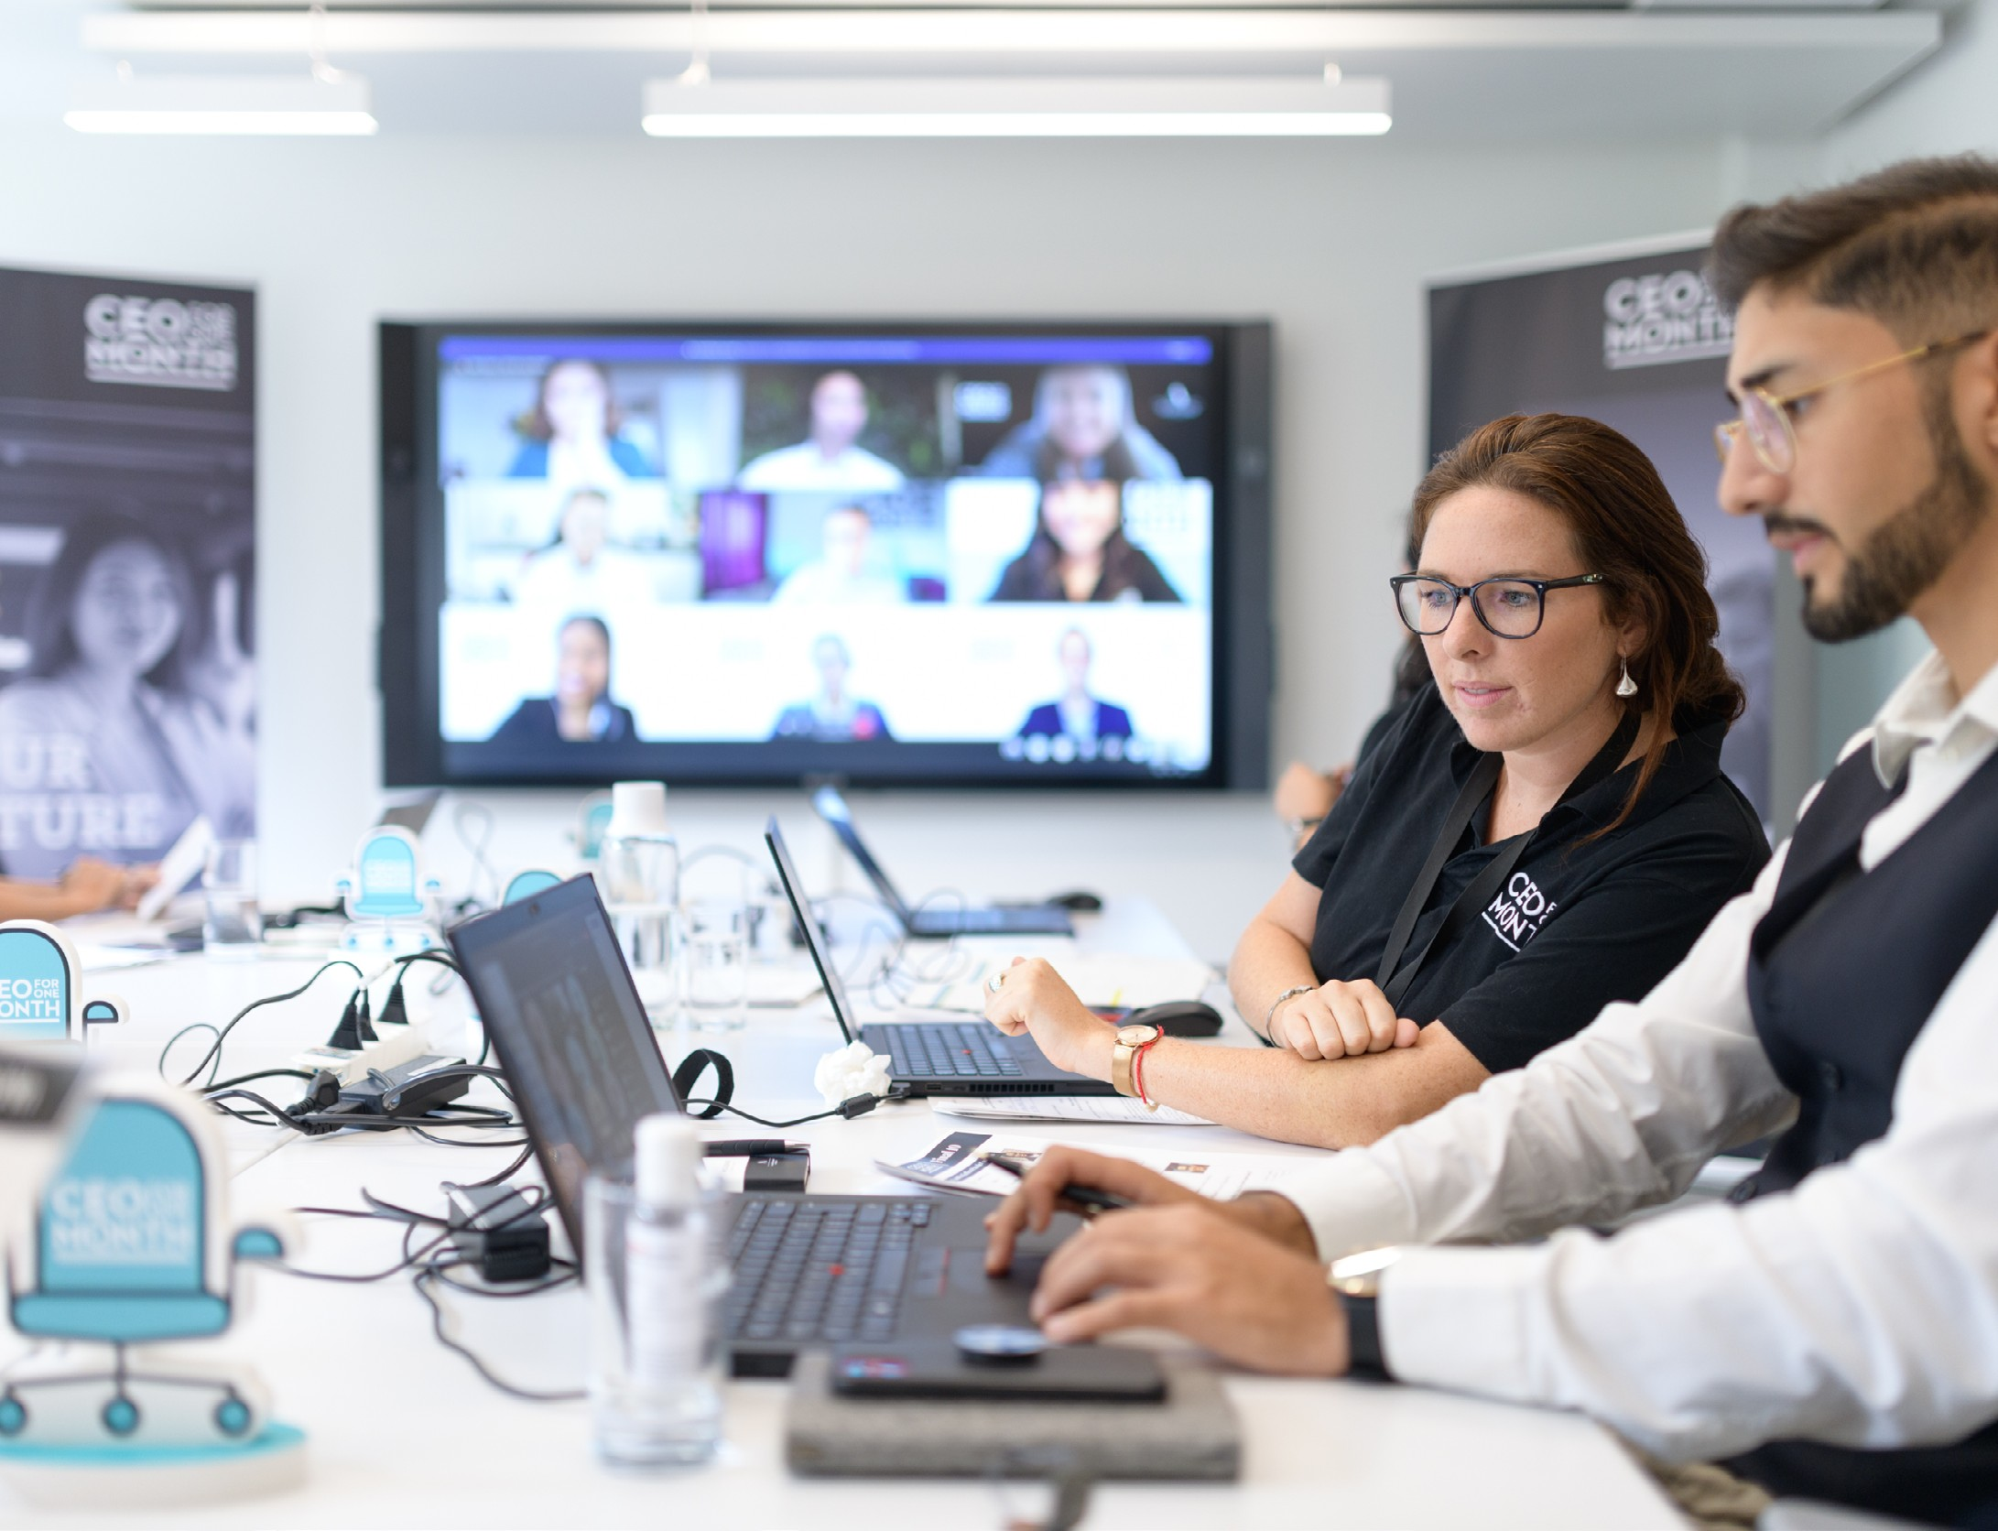
‘CEO for One Month’ is an initiative that offers young people the possibility to develop and showcase their potential, to learn what it takes to succeed as a business leader and to acquire the skills and the experience needed to get a foot on the career ladder.
At national level, one successful candidate is selected from the applicant pool to shadow the Adecco Group’s country- level CEO for one full month, working side by side and experience the daily life of a senior business leader.
Ten outstanding national participants are then selected for a Global Bootcamp and one is chosen to work alongside and shadow the Global CEO of the Adecco Group for another month.
Following their time with the country managers, a number of participants of the programme stay with the Adecco Group, kickstarting their career!

Slide 7

What if one of your students could become the Adecco Group’s next Global ‘CEO forOne Month’?
206,000 Registrations in 2020
Help your students discover themselves!
Every applicant is invited to a series of online assessments designed to analyze their reasoning skills, situational judgement and personality traits. After completing the assessments, candidate receives a thorough feedback report.

Slide 8
Experience
Work Day

Slide 9
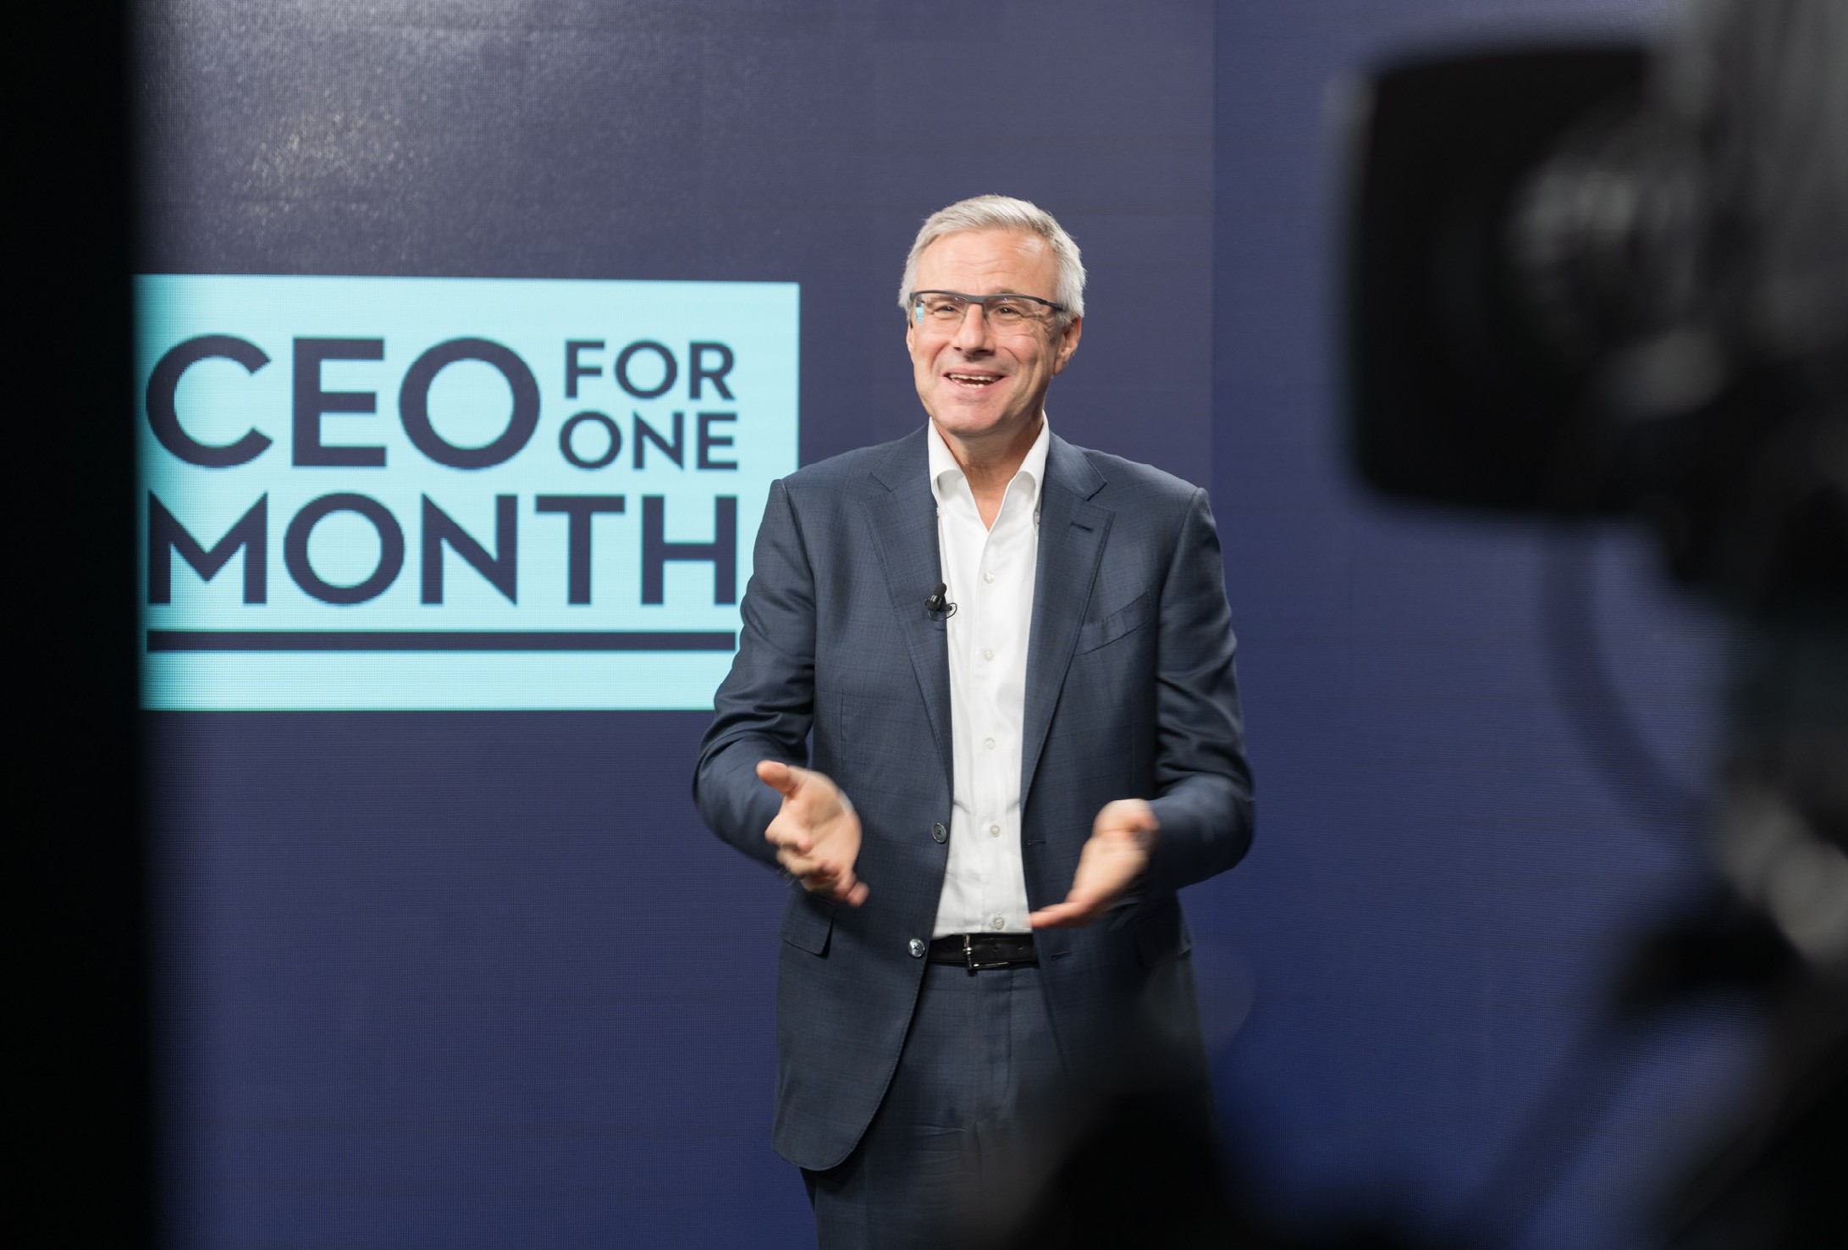
Experience Work Day
One week in November
The Global ‘Experience Work Day’ follows the success of the Adecco Group Street Day, a great initiative that supports people in gaining a better start in the world of work.
This idea was introduced in 2013 to tackle youth unemployment and skills shortages, develop young people’s employability and help them enter the world of work.
On Experience Work Day the Adecco Group and all its brands open their doors to thousands of young people to spend a day in the shoes of an employee, take part in different activities and workshops and provide real work experience that kick starts their career.
To guarantee participants’ safety, the 2020 edition of the Experience Work Day moved entirely online. Over 5,500 participants attended over 50 online sessions, organized in 18 languages by Adecco Group’s staff and partners in 26 countries accross the globe.

Slide 10
Key dates
‘CEO for One Month‘ + Experience Work Day
January 11
Registrations Open
March 19
First group of participating countries closes registrations
April 16
Second group of participating countries closes registrations
April 16 - May 27
Country selection process
May 28 | August 23 - 24
Country CEO’s | Global Bootcamp
announcement
June - August | August 25
Country-level | Global ‘CEO for One
shadowing month | Month‘ announcement
Early August Global Selection | August 30 - September 30
Process | Global shadowing month
August 13 | November
Bootcamp Finalists | Experience Work Day
announcement

Slide 11
Give this chance to your
students!
Share the information with your students and contact us for more details

